Slide 1
Browsing Genomic Information with Ensembl Plants
Dan Bolser
(adapted from slides by Bert Overduin)

Slide 2
Outline of workshop
Brief introduction to Ensembl Plants
History
Content
Tutorial (~1:30h)
Interactive exercises and answers…
Presentation:
Triticeae data in Ensembl Plants
Wheat
Barley

Slide 3
Ensembl & Ensembl Genomes
1999: Start of Ensembl project (Human Genome)
2001: First release of data and web interface
2002: Mouse, mosquito, fugu, zebrafish and rat added
…
2009: First release of Ensembl Genomes
…
2012: Ensembl (v69): 71 genomes
2012: Ensembl Genomes (v16): 359 genomes

Slide 4
Ensembl & Ensembl Genomes
Vertebrates
Annotation in-house by the Ensembl project
European Bioinformatics Institute & Wellcome Trust Sanger Institute
Invertebrates, plants, fungi, protists and bacteria
Annotation by or in collaboration with the scientific community
European Bioinformatics Institute

Slide 5
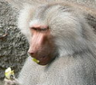
Species in Ensembl
Primates
Rodents etc.
Laurasiatheria
Afrotheria
Xenartha
Other mammals
Birds & reptiles
Amphibians
Fish
Other chordates
Other eukaryotes
On Pre! Ensembl

Slide 6
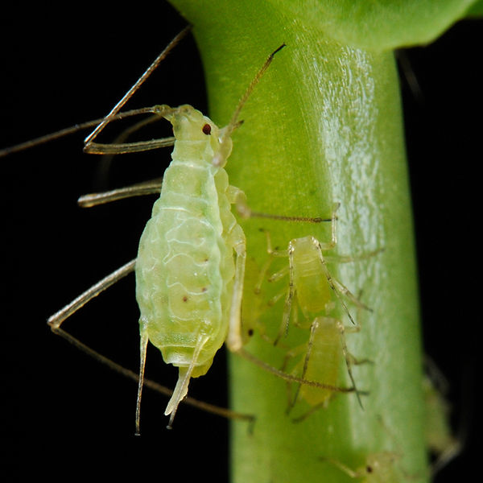
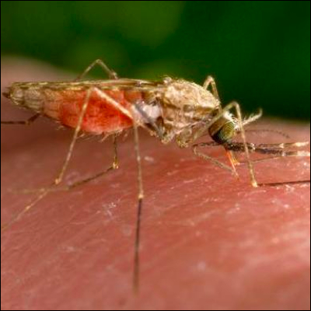
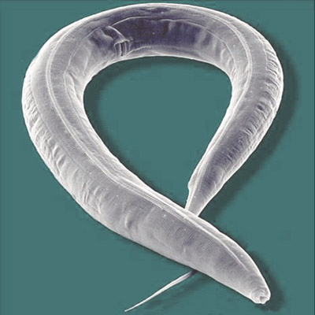
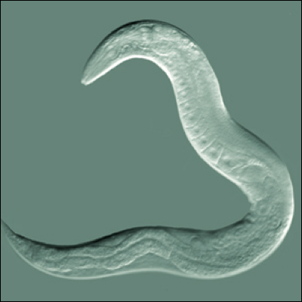
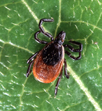
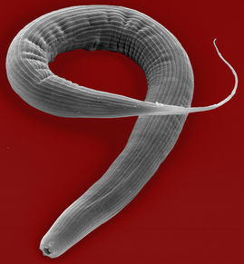
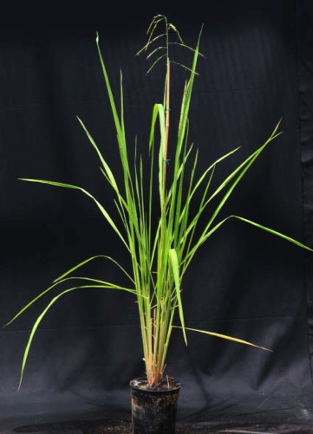
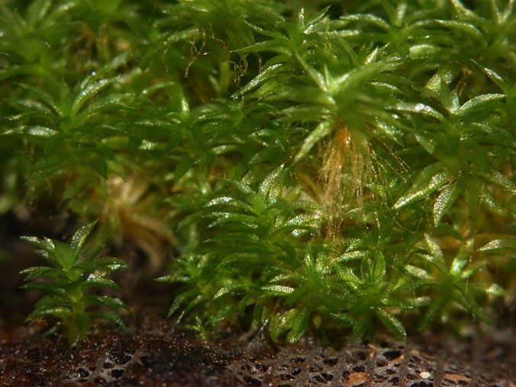
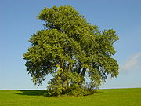
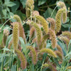
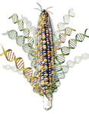
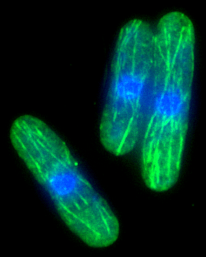
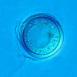
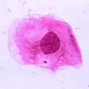
Species in Ensembl Genomes

Slide 7
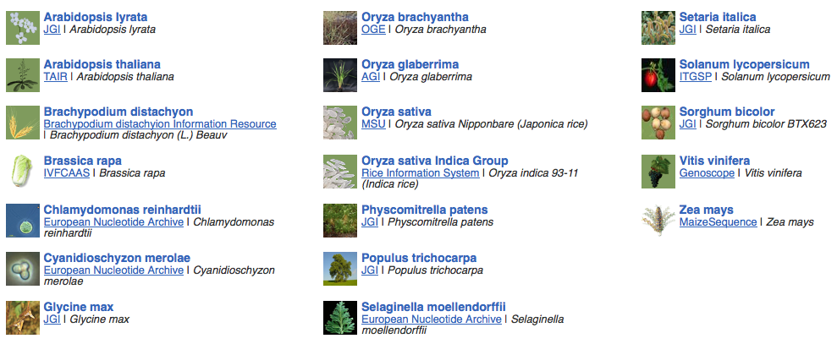
Species Ensembl Plants

Slide 8
Data
Genomic sequence
Gene / transcript / protein models
External references
Mapped sequences
cDNAs, proteins, repeats, markers, probes, etc.
Variation data:
sequence variants
structural variants

Slide 9
Data
Comparative data:
Orthologues and paralogues (between plants and pan-taxonomic)
Protein families
Whole genome pairwise alignments (selected species)
Synteny (selected species)
8-way whole genome multiple alignment

Slide 10
Expected … sooner or later
Barley (Hordeum vulgare)
Potato (Solanum tuberosum)
Bread wheat (Triticum aestivum)
Medicago (Medicago truncatula)
Pigeon pea (Cajanus cajan)
Papaya (Carica papaya)
Cucumber (Cucumus sativus)
Domesticated apple (Malus x domestica Borkh.)
Woodland strawberry (Fragaria vesca)
Norway Spruce (Picea abies) (18 Gb!)

Slide 11
Access to data
Web browser
http://plants.ensembl.org
BioMart
http://plants.ensembl.org/biomart/martview/
FTP
ftp://ftp.ensemblgenomes.org/pub/plants/
http://plants.ensembl.org/info/data/ftp/
Public MySQL server
mysql.ebi.ac.uk:4157:anonymous
Ensembl APIs
http://plants.ensembl.org/info/docs/api/
http://beta.rest.ensembl.org/

Slide 12
BioMart
Data retrieval tool
Originally developed for Ensembl (EnsMart)
Now used by many large data resources
Integrated with several widely used software packages, e.g. Galaxy, BioConductor
Joint project between the European Bioinformatics Institute (EBI) and the Ontario Institute for Cancer Research (OICR)
Central portal: http://www.biomart.org

Slide 13
Help
Helpdesk helpdesk@ensemblgenomes.org
Mailing lists http://plants.ensembl.org/info/about/contact/mailing.html
YouTube and YouKu (优酷网) channels http://www.youtube.com/user/EnsemblHelpdesk http://u.youku.com/user_show/uid_Ensemblhelpdesk

Slide 14
Workshops
Browser (0.5-2 days) and API (1-3 days) workshops
Combination of lectures and hands-on exercises
Advertised on http://www.ensembl.info/workshops/calendar/
You can host your own workshop!
For academic institutions there is no fee, apart from the instructor’s expenses
You only need a computer room and participants
You can get more info from helpdesk@ensembl.org or bert@ebi.ac.uk

Slide 15
Ensembl Genomes

Slide 16
Tutorial

Slide 17
Tutorial objectives
After this tutorial you should be able to:
Search and navigate the Ensembl Plants website.
Understand Ensembl Plants annotation.
How to attach and visualize your BAM and VCF data.
Retrieve Ensembl Plants data using BioMart.
Know where to find help and documentation.

Slide 18
Background: G6PD
Glucose-6-phosphate dehydrogenase (G6PD or G6PDH) is a cytosolic enzyme in the pentose phosphate pathway, a metabolic pathway that supplies reducing energy to cells by maintaining the level of the co-enzyme nicotinamide adenine dinucleotide phosphate (NADPH).
G6PD is widely distributed in many species from bacteria to humans. In higher plants, several isoforms of G6PDH have been reported, which are localized in the cytosol, the plastidic stroma, and peroxisomes.
http://en.wikipedia.org/wiki/Glucose-6-phosphate_dehydrogenase

Slide 19
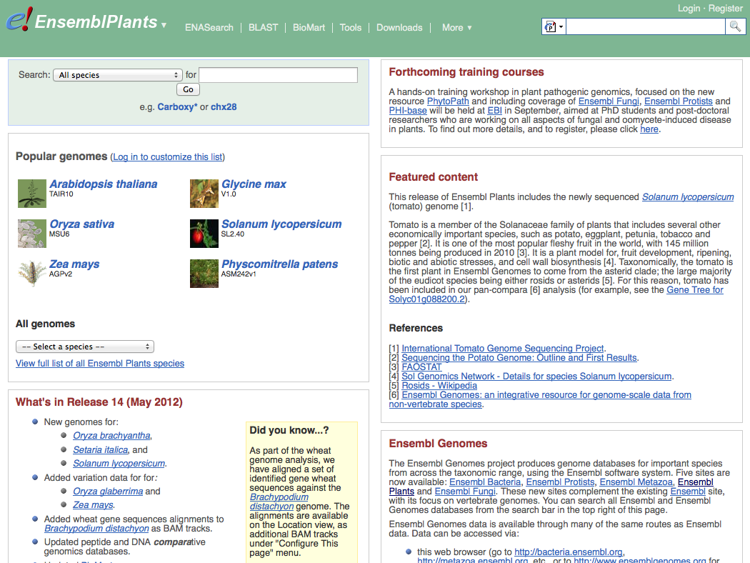
Search
Species pages
Info on current release

Slide 20
Exercise 1
Go to the Ensembl Plants homepage (http://plants.ensembl.org).
What is the current release (version) of Ensembl Plants?
On which data are the genome sequence and gene annotation for Arabidopsis thaliana based?

Slide 21
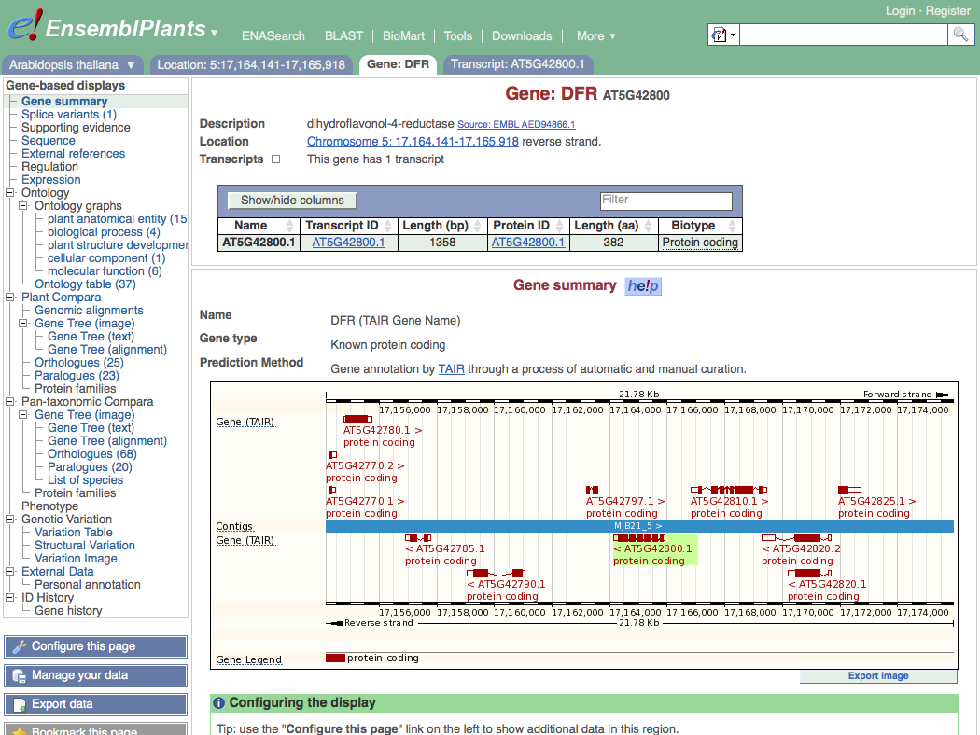
Top panel stays the same as long as you stay on the same tab
Gene tab
Main panel changes when you choose another page from the side menu
he!p
Side menu

Slide 22
Exercise 2
Find the Arabidopsis thaliana gene encoding glucose-6-phosphate dehydrogenase 1
What is the official gene name for this gene?
On which chromosome and on which strand is it located?
What do the empty boxes, filled boxes and lines in the transcript models represent?

Slide 23
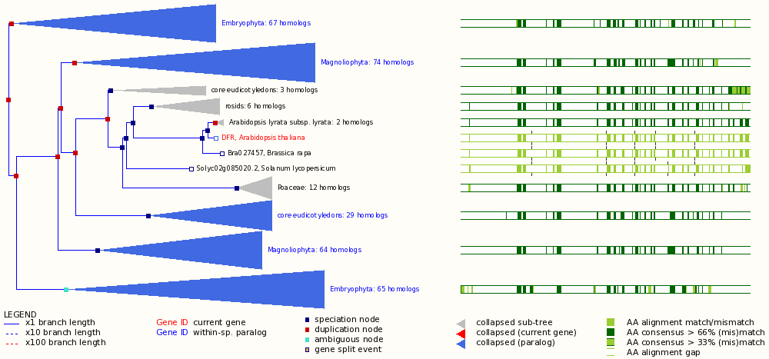
Phylogenetic GeneTree
Protein multiple alignment
Duplication node
Gene of interest
Speciation node
Gap
(Mis)match
Collapsed sub tree

Slide 24
Exercise 3
Explore the ‘Paralogues’ and ‘Gene Tree’ pages.
How many paralogues have been identified for the G6PD1 gene? Which paralogues show the highest sequence similarity?
Does the plant gene tree reflect the information that is shown on the ‘Paralogues’ page?
Does the pan-taxonomic gene tree confirm that glucose-6-phosphate dehydrogenase is present in species across all kingdoms?

Slide 25
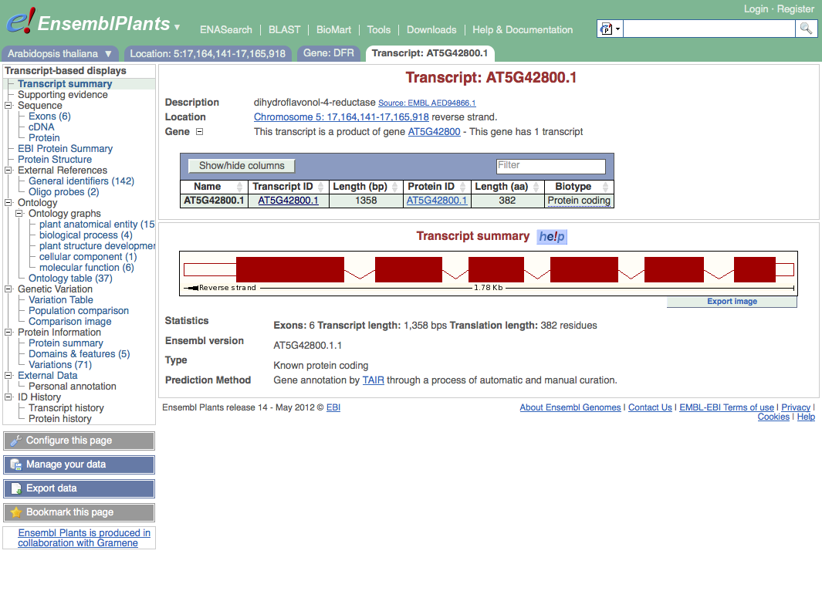
Transcript tab
Changed side menu

Slide 26
Exercise 4
Explore the G6PD1 transcript and protein (AT5G35790.1).
How many exons does this transcript have? Is any of them (partially) untranslated?
Is it cross-referenced to the UniProtKB/Swiss-Prot database? What is its ID and recommended name according to UniProtKB/Swiss-Prot?
Does any of the associated Gene Ontology (GO) terms hint at a role of glucose-6-phosphate dehydrogenase 1 in the pentose phosphate pathway?
Where in the cell is glucose-6-phosphate dehydrogenase 1 located?
In which part of the glucose-6-phosphate dehydrogenase 1 protein is its NAD binding domain located?

Slide 27
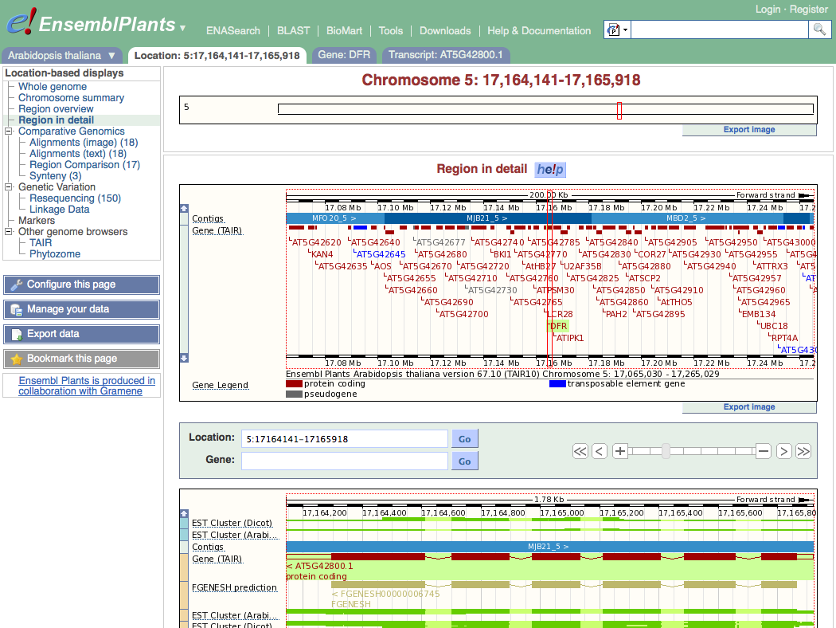
Location tab
Chromosome
Top panel:
Overview
Add tracks
Add your own data
Main panel:
Zoom in, zoom out
Add tracks and remove tracks
Add your own data
Tracks

Slide 28
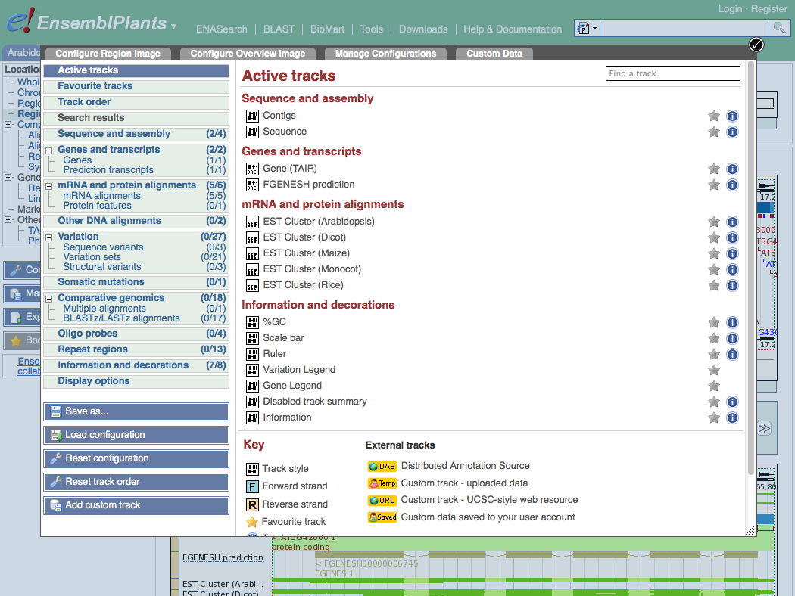
Categories of tracks
Search tracks
Turn track on/off

Slide 29
Exercise 5
Explore the genomic region of the G6PD1 gene.
Which species in Ensembl Plants shows the highest sequence conservation for this region when compared to Arabidopsis thaliana? And which species the lowest?
What part of the sequence is most conserved across the various species? Is this what you would expect?

Slide 30
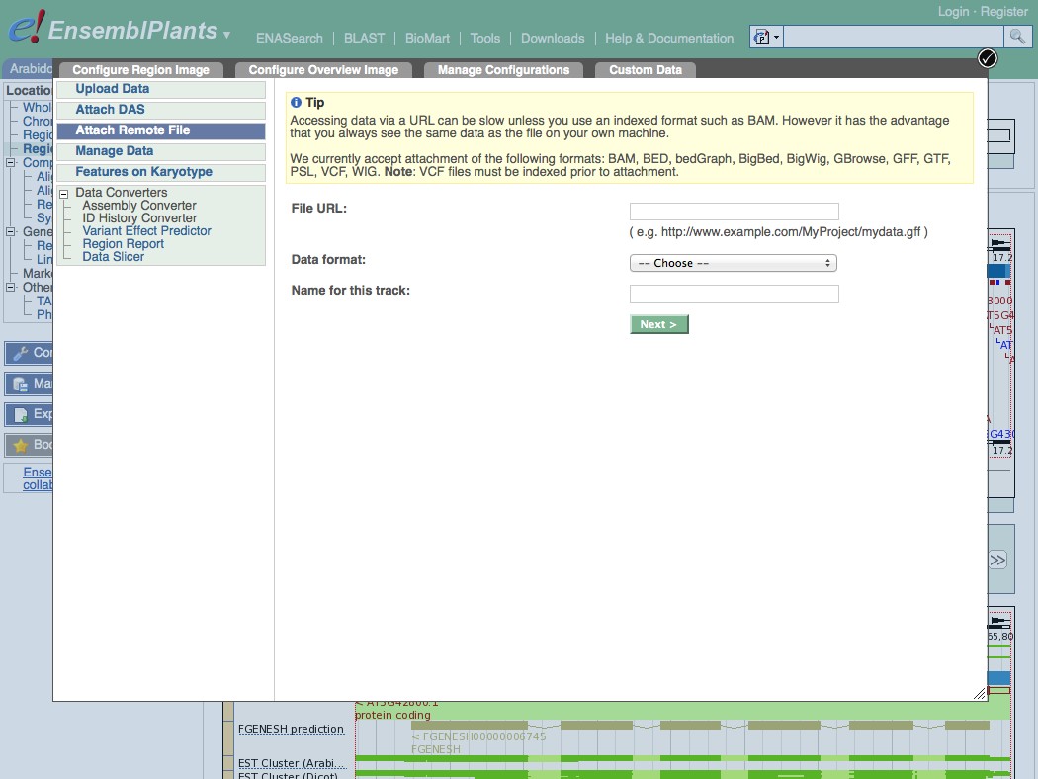
Add your own data
Location of your data

Slide 31
Exercise 6
 Attach the following file, that contains RNA-Seq data for a wild type Arabidopsis thaliana seedling, to Ensembl Plants: http://www.ebi.ac.uk/~bert/SRR070570.bam
Is the G6PD1 gene expressed?
Compare its expression to a gene that is:
expected to be constitutively highly expressed, e.g. RBCS1A (ribulose bisphosphate carboxylase small chain 1A), and
one that is not, e.g. PR1 (pathogenesis-related protein 1).

Slide 32
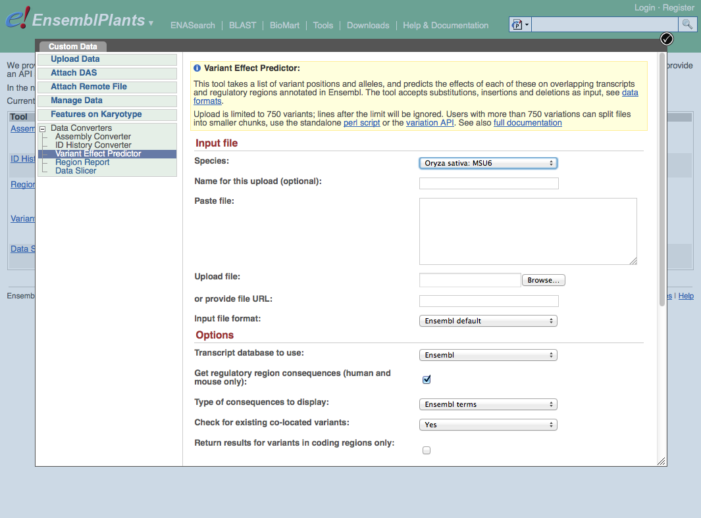
Paste data
… or upload file
… or provide URL

Slide 33
Exercise 7
The following file contains the genomic coordinates and alleles of a number of new variants in the G6PD1 gene of Arabidopsis thaliana: http://www.ebi.ac.uk/~bert/athaliana_g6pd1_new_variants.txt
Do any of these variants change the sequence of the glucose-6-phosphate dehydrogenase 1 protein?
Have any of the variants already been annotated in Ensembl?

Slide 34
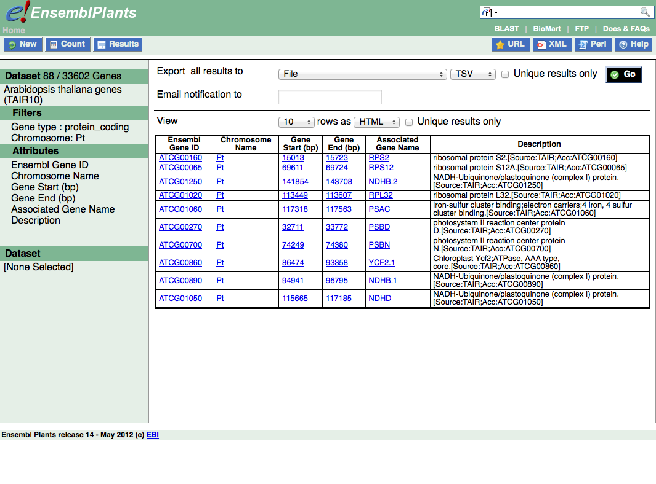
Step 4
Step 1
Step 2
Export results to file
Step 3
Preview of results

Slide 35
BioMart
Step 1 – Dataset
Choose your dataset and species
Step 2 – Filters
Limit your dataset
Step 3 – Attributes
Specify what information you want to output
Step 4 – Results
Preview and output your results

Slide 36
Exercise 8
Select the Ensembl Genes dataset for Arabidopsis thaliana.
Filter for all genes that are annotated with the GO term ‘pentose-phosphate shunt’, the official GO term for the pentose-phosphate pathway (http://amigo.geneontology.org/cgi-bin/amigo/term_details?term=GO:0006098 )
Select the following attributes: Ensembl Gene ID, Associated Gene Name and Description.
View the results.
How many genes does the query find?
Are all G6PD genes amongst the results?

Slide 37
Explore your favorite genes!

Slide 38
Acknowledgments
team
Dan Bolser, Paul Davies, Paul Derwent, Christoph Grabmüller, Kevin Howe, Daniel Hughes, Jay Humphrey, Arnaud Kerhornou, Paul Kersey, Eugene Kulesha, Nick Langridge, Dan Lawson, Uma Maheswari, Gareth Maslen, Mark McDowall, Karyn Megy, Michael Nuhn, ChuangKee Ong, Michael Paulini, Helder Pedro, Dan Staines, Iliana Toneva, Mary-Ann Tuli, Gareth Williams, Derek Wilson
team
Collaborators: Gramene, Rothamsted Research
Funding: EMBL, EU-FP7, BBSRC

